Slide 1

Federated Learning: GAN approach
Presented by Trong-Binh Nguyen-202388548 Pusan National University
December 7th, 2023

Slide 2
Table of contents
Federated Learning
Introduction
Basic structure
Challenges
GANs
Introduction
Ideas
Federated Distillation via
Generative Learning
Knowledge distillation
KL Divergence
Latent space
Results
Performance
Code

Slide 3
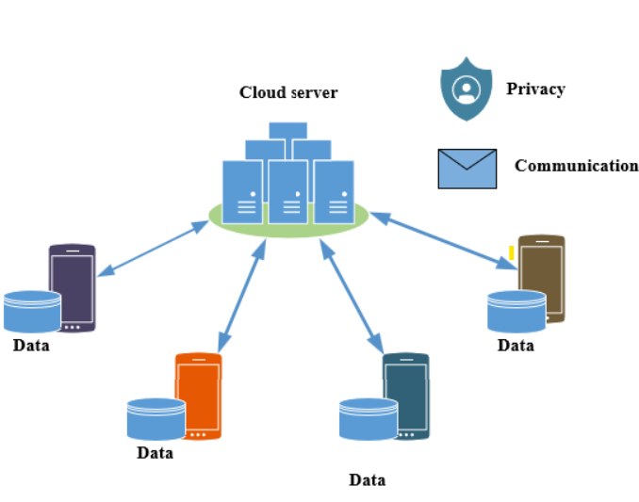
1. Federated Learning: Introduction
Technology advance:
Advantages:
Data explosion
Deep insights into data distribution
Disadvantages:
Privacy of users
Communication overhead
Federated Learning
Decentralized Learning technique
Provides privacy
Good performance

Slide 4
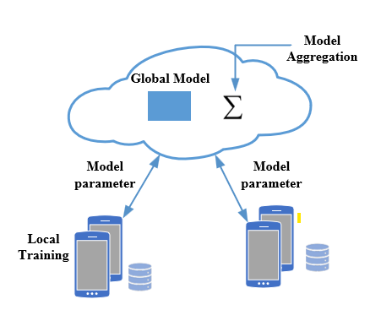
1. Federated Learning: Basic structure
Server:
Global model initialization
Receive client model parameters update
Performing optimization based on parameters
Sending back parameters to clients
Clients:
Training based on the local client dataset
Sending model update to the server
Model Architecture:
Server and client share the same model architecture but different parameters
Design model suitable for the tasks
Note:
Only parameters communicated

Slide 5
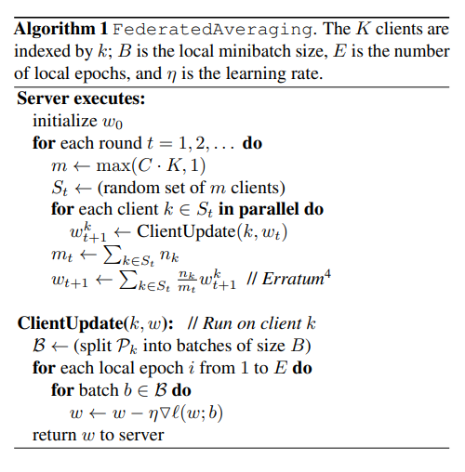


1. Federated Learning: Basic Algorithm
Training on the local clients using gradient descent.
Perform the simple aggregation step as averaging in FedAvg
H. B. McMahan, E. Moore, D. Ramage, S. Hampson, and B. A. y Arcas, “Communication-efficient learning of deep networks from decentralized data,” 2016 Google Research paper

Slide 6
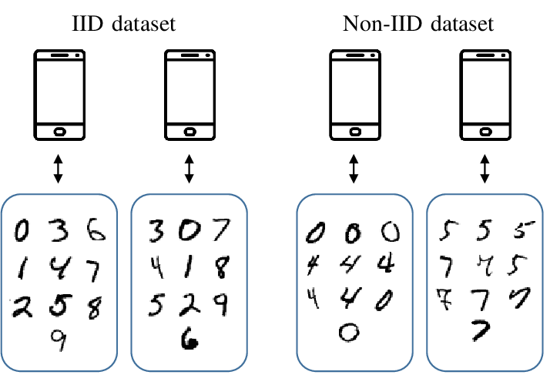
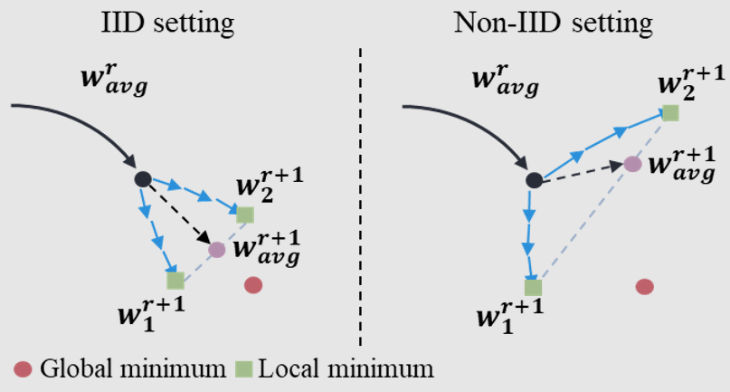
1. Federated Learning: Challenges
Heterogeneity - non IID:
Devices in a federated learning system may have different types of data
Data from different sources, leading to variations in data distributions.

Slide 7
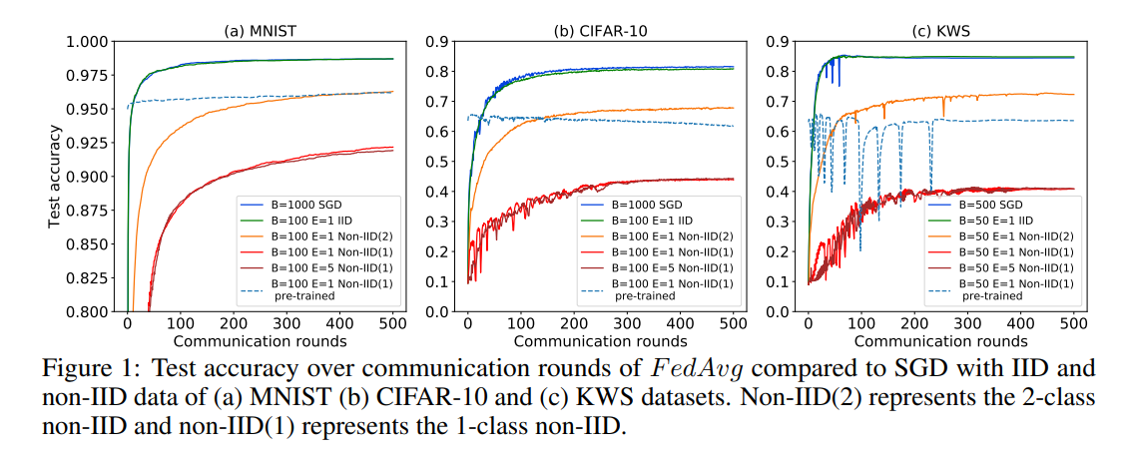
1. Federated Learning: Challenges
Zhao, Yue, et al. "Federated learning with non-iid data." arXiv preprint arXiv:1806.00582 (2018).

Slide 8
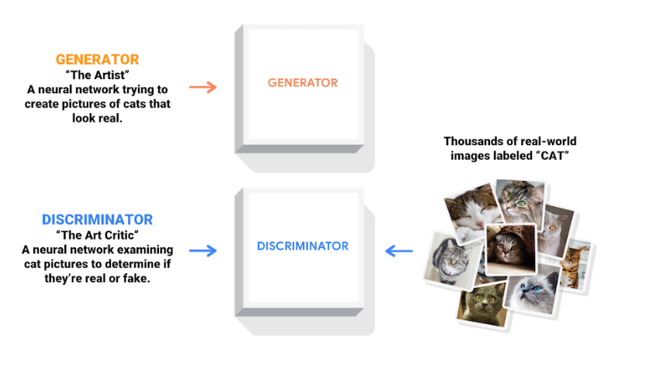
2. GANs: Introduction
Adversarial Networks (GANs) are a class of artificial intelligence algorithms introduced by Ian Goodfellow and his colleagues in 2014.
GANs are designed for generative tasks, aiming to create new data instances that resemble a given dataset.
GANs consist of two models: generator and discriminator

Slide 9
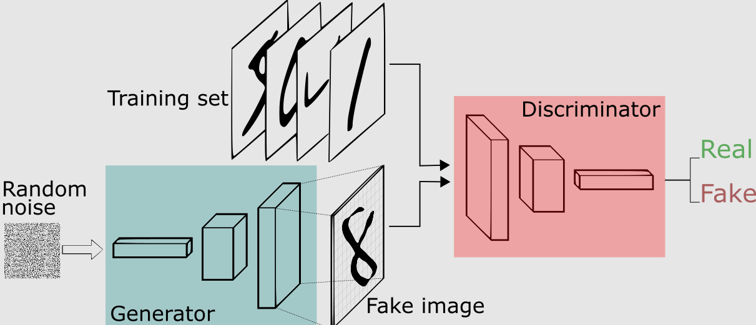
2. GANs
Generator (G):
The generator is a neural network responsible for creating synthetic data.
It takes random noise as input and transforms it into data that should resemble the real data.
Discriminator (D):
The discriminator is another neural network that acts as a binary classifier.
It distinguishes between real data from the dataset and fake data generated by the generator

Slide 10


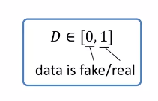

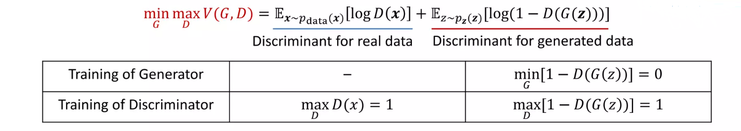

2. GANs
Minimax problem of GANs
Input random noise:
Generator data:
Discriminator:
Two-player game between Generator vs Discriminator

Slide 11
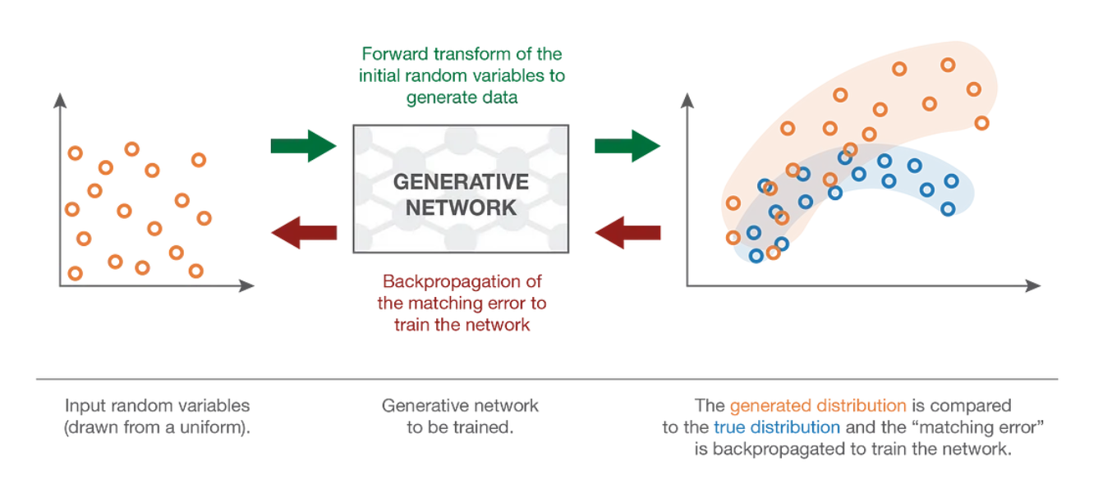
2. GANs

Slide 12
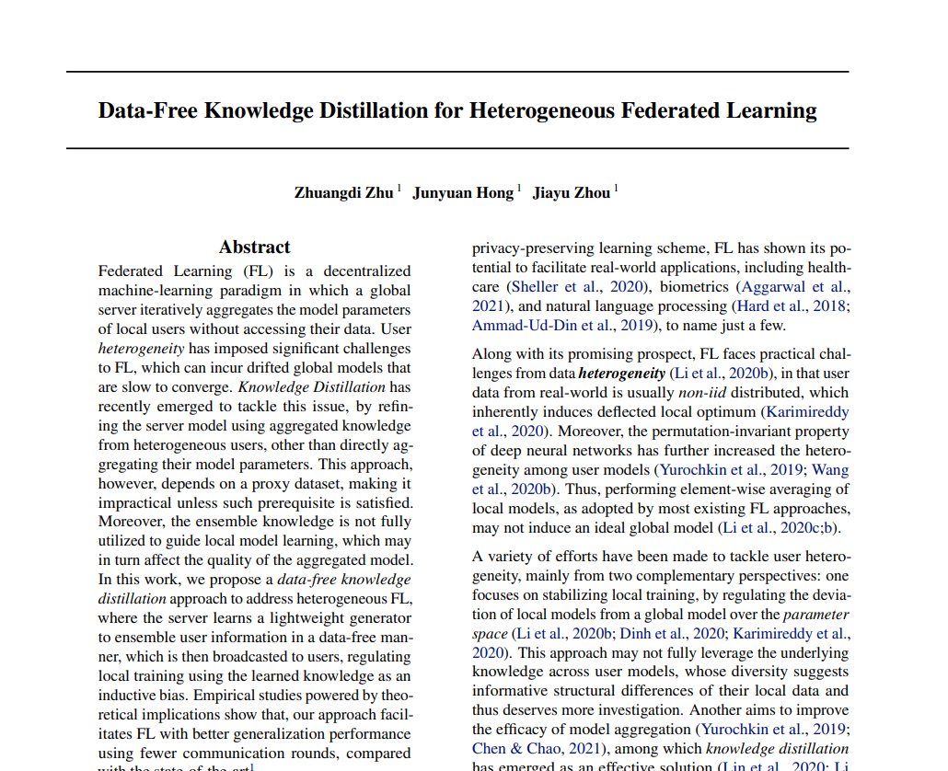
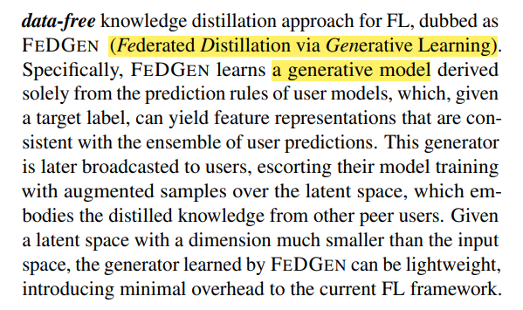
3. FedGen: Federated Distillation via Generative Learning
Zhu, Zhuangdi, Junyuan Hong, and Jiayu Zhou. "Data-free knowledge distillation for heterogeneous federated learning." International conference on machine learning. PMLR, 2021.

Slide 13
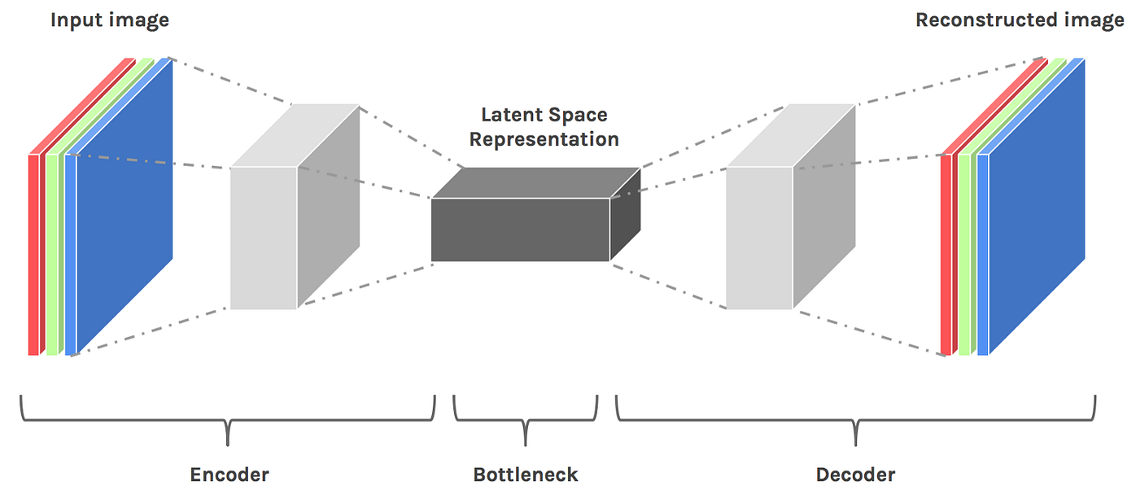
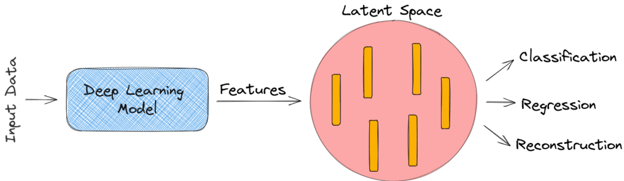
3. FedGen: Latent Space Z
The term is commonly used in the context of machine learning, particularly in the fields of unsupervised learning and generative modeling.
It refers to a space in which the representations of data are learned in an unsupervised manner, often with the goal of capturing the underlying structure or features of the data.

Slide 14
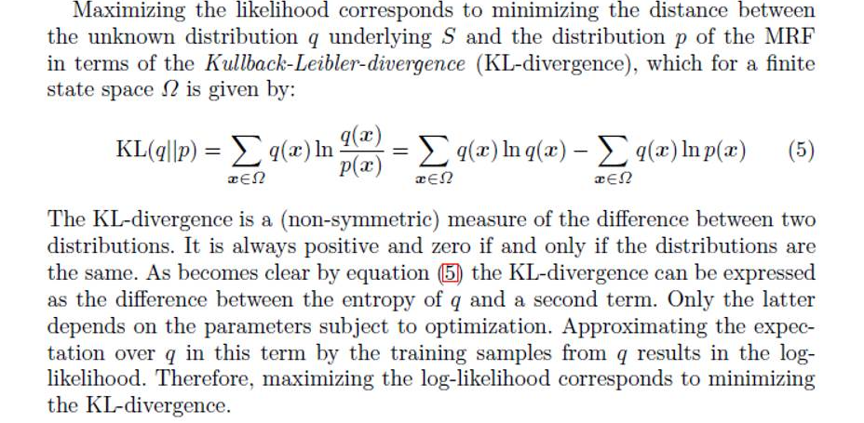
3. FedGen: KL Divergence
Kullback-Leibler (KL) Divergence is a measure of how one probability distribution diverges from a second

Slide 15
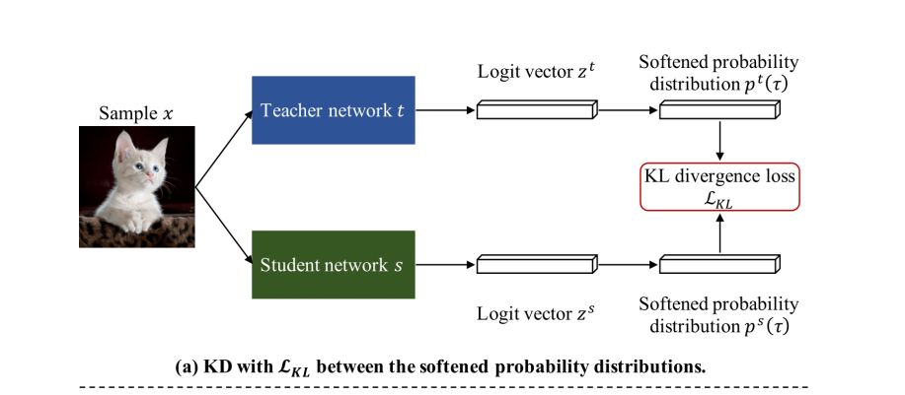
3. FedGen: Knowledge Distillation
Knowledge Distillation is a technique in machine learning where a smaller model, known as the student model, is trained to reproduce the behavior of a larger, more complex model, known as the teacher model.
The goal is to transfer the knowledge captured by the teacher model to the smaller student model.

Slide 16

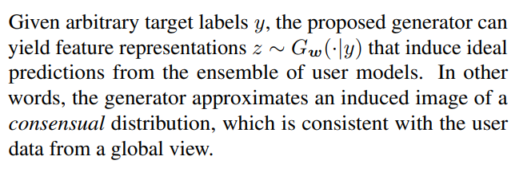



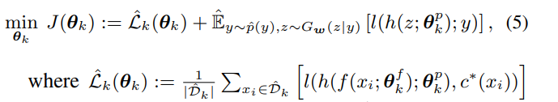

3. FedGen: Idea
Target
A model parameterized by
A feature extractor
A predictor h:
Server training
Local training

Slide 17
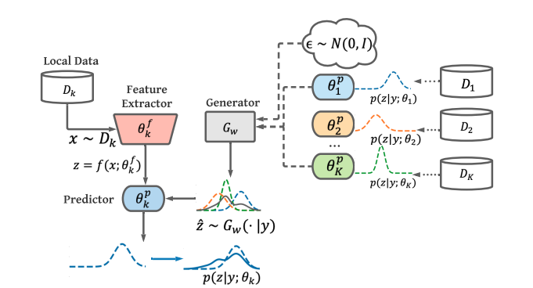
3. FedGen: Idea

Slide 18
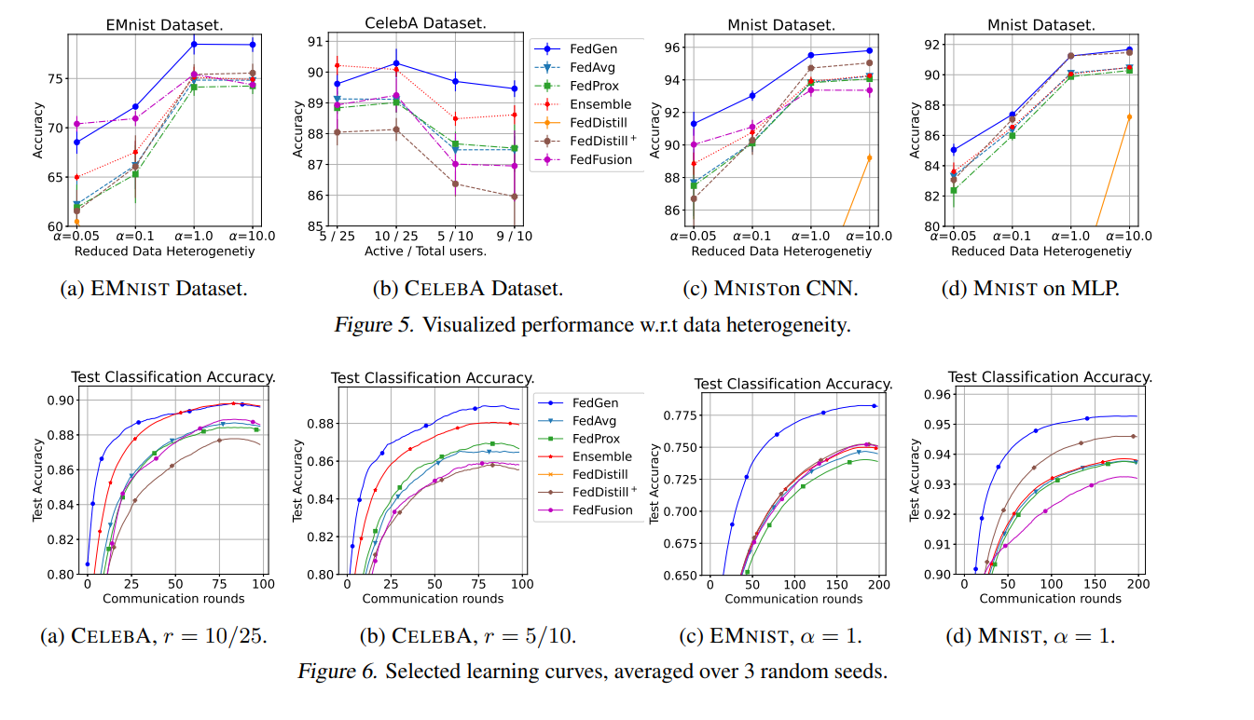
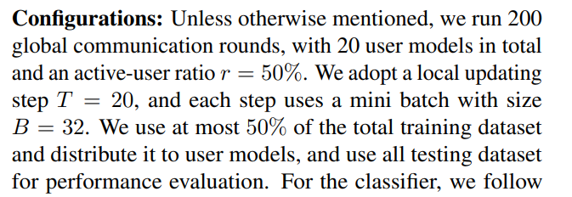
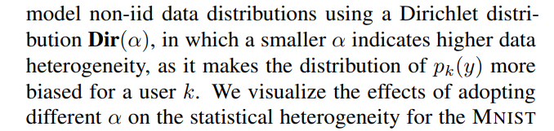
4. Results: Performance
https://github.com/zhuangdizhu/FedGen.git

Slide 19
QUESTION TIME

